Slide 1
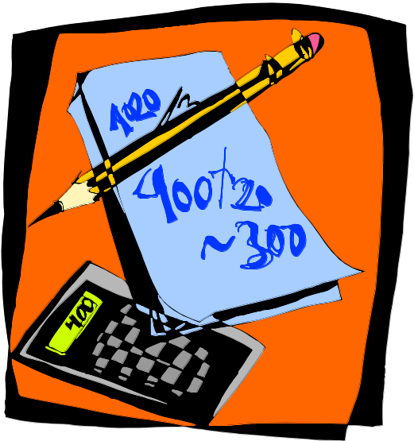
Addition and multiplication
Arithmetic is the most basic thing you can do with a computer, but it’s not as easy as you might expect!
These next few lectures focus on addition, subtraction, multiplication and arithmetic-logic units, or ALUs, which are the “heart” of CPUs.

Slide 2
Binary addition by hand
You can add two binary numbers one column at a time starting from the right, just as you add two decimal numbers.
But remember that it’s binary. For example, 1 + 1 = 10 and you have to carry!
The initial carry
in is implicitly 0
1 1 1 0 Carry in
1 0 1 1 Augend
+ 1 1 1 0 Addend
1 1 0 0 1 Sum
most significant
bit, or MSB
least significant
bit, or LSB

Slide 3
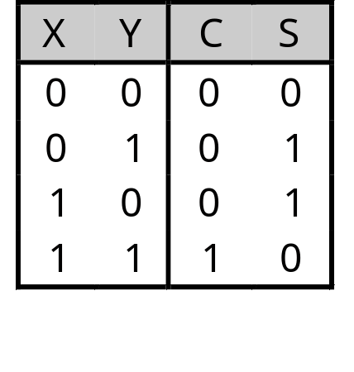
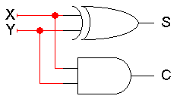
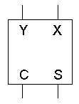

Adding two bits
We’ll make a hardware adder by copying the human addition algorithm.
We start with a half adder, which adds two bits and produces a two-bit result: a sum (the right bit) and a carry out (the left bit).
Here are truth tables, equations, circuit and block symbol.
0 + 0 = 0
0 + 1 = 1
1 + 0 = 1
1 + 1 = 10
C = XY
S = X’ Y + X Y’
= X ⊕ Y
Be careful! Now we’re using + for both arithmetic addition and the logical OR operation.

Slide 4
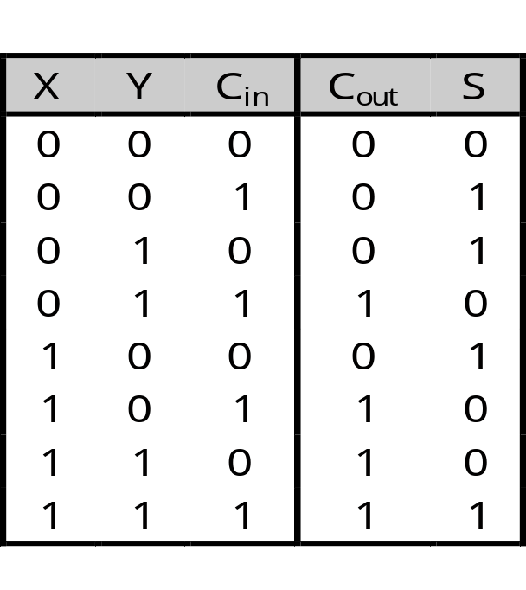
Adding three bits
But what we really need to do is add three bits: the augend and addend, and the carry in from the right.
1 1 1 0
1 0 1 1
+ 1 1 1 0
1 1 0 0 1
0 + 0 + 0 = 00
0 + 0 + 0 = 01
0 + 1 + 0 = 01
0 + 1 + 1 = 10
1 + 0 + 0 = 01
1 + 0 + 1 = 10
1 + 1 + 0 = 10
1 + 1 + 1 = 11

Slide 5
Full adder equations
A full adder circuit takes three bits of input, and produces a two-bit output consisting of a sum and a carry out.
Using Boolean algebra, we get the equations shown here.
  XOR operations simplify the equations a bit.
  We used algebra because you can’t easily derive XORs from K-maps.
S = Σm(1,2,4,7)
= X’ Y’ C_{in} + X’ Y C_{in}’ + X Y’ C_{in}’ + X Y C_{in}
= X’ (Y’ C_{in} + Y C_{in}’) + X (Y’ C_{in}’ + Y C_{in})
= X’ (Y ⊕ C_{in}) + X (Y ⊕ C_{in})’
= X ⊕ Y ⊕ C_{in}
C_{out} = Σm(3,5,6,7)
= X’ Y C_{in} + X Y’ C_{in} + X Y C_{in}’ + X Y C_{in}
= (X’ Y + X Y’) C_{in} + XY(C_{in}’ + C_{in})
= (X ⊕ Y) C_{in} + XY

Slide 6
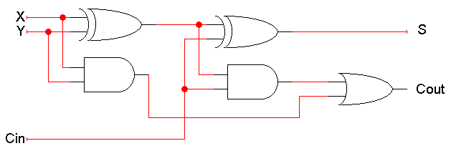
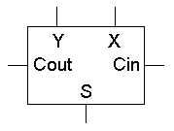
Full adder circuit
These things are called half adders and full adders because you can build a full adder by putting together two half adders!
S = X ⊕ Y ⊕ C_{in}
C_{out} = (X ⊕ Y) C_{in} + XY

Slide 7
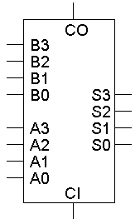
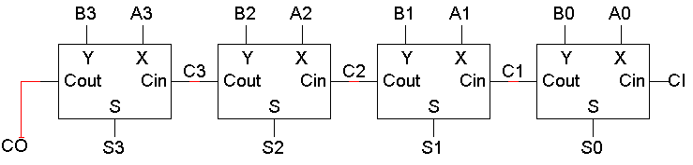
A 4-bit adder
Four full adders together make a 4-bit adder.
There are nine total inputs:
  Two 4-bit numbers, A3 A2 A1 A0 and B3 B2 B1 B0
  An initial carry in, CI
The five outputs are:
  A 4-bit sum, S3 S2 S1 S0
  A carry out, CO
Imagine designing a nine-input adder without this hierarchical structure—you’d have a 512-row truth table with five outputs!

Slide 8
An example of 4-bit addition
Let’s try our initial example: A=1011 (eleven), B=1110 (fourteen).
1 1 1 0 1 1 0 1
0
1
1
0
1 1
0
0
1
1. Fill in all the inputs, including CI=0
2. The circuit produces C1 and S0 (1 + 0 + 0 = 01)
3. Use C1 to find C2 and S1 (1 + 1 + 0 = 10)
4. Use C2 to compute C3 and S2 (0 + 1 + 1 = 10)
5. Use C3 to compute CO and S3 (1 + 1 + 1 = 11)
Woohoo! The final answer is 11001 (twenty-five).

Slide 9
Overflow
In this case, note that the answer (11001) is five bits long, while the inputs were each only four bits (1011 and 1110). This is called overflow.
Although the answer 11001 is correct, we cannot use that answer in any subsequent computations with this 4-bit adder.
For unsigned addition, overflow occurs when the carry out is 1.

Slide 10
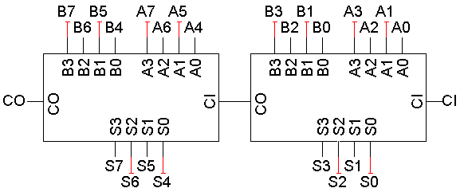
Hierarchical adder design
When you add two 4-bit numbers the carry in is always 0, so why does the 4-bit adder have a CI input?
One reason is so we can put 4-bit adders together to make even larger adders! This is just like how we put four full adders together to make the 4-bit adder in the first place.
Here is an 8-bit adder, for example.

Slide 11

Gate delays
Every gate takes some small fraction of a second between the time inputs are presented and the time the correct answer appears on the outputs. This little fraction of a second is called a gate delay.
There are actually detailed ways of calculating gate delays that can get quite complicated, but for this class, let’s just assume that there’s some small constant delay that’s the same for all gates.
We can use a timing diagram to show gate delays graphically.
1
x
x’
0
gate delays

Slide 12
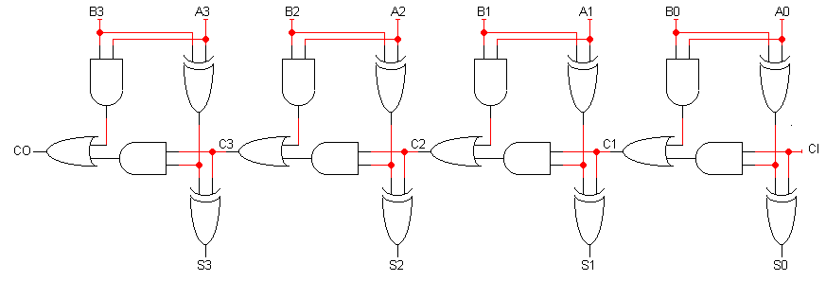
Delays in the ripple carry adder
The diagram below shows a 4-bit adder completely drawn out.
This is called a ripple carry adder, because the inputs A₀, B₀ and CI “ripple” leftwards until CO and S₃ are produced.
Ripple carry adders are slow!
  Our example addition with 4-bit inputs required 5 “steps.”
  There is a very long path from A₀, B₀ and CI to CO and S₃.
  For an n-bit ripple carry adder, the longest path has 2n+1 gates.
  Imagine a 64-bit adder. The longest path would have 129 gates!
1
9
8
7
6
5
4
3
2

Slide 13
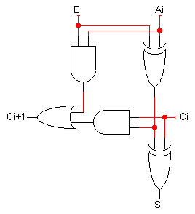
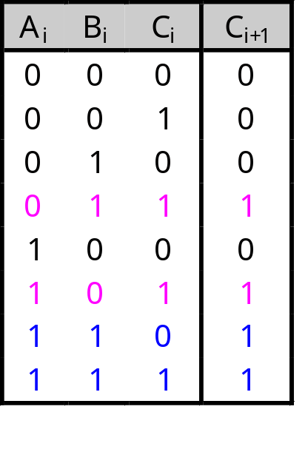
A faster way to compute carry outs
Instead of waiting for the carry out from all the previous stages, we could compute it directly with a two-level circuit, thus minimizing the delay.
First we define two functions.
  The “generate” function g_{i} produces 1 when there must be a carry out from position i (i.e., when A_{i} and B_{i} are both 1).
g_{i} = A_{i}B_{i}
  The “propagate” function p_{i} is true when, if there is an incoming carry, it is propagated (i.e, when A_{i}=1 or B_{i}=1, but not both).
p_{i} = A_{i} ⊕ B_{i}
Then we can rewrite the carry out function:
c_{i+1} = g_{i} + p_{i}c_{i}
g_{i}
p_{i}

Slide 14
A Note On Propagation
We could have defined propagation as A + B instead of A ⊕ B
  As defined, it captures the case when we propagate but don’t generate
    I.e., propagation and generation are mutually exclusive
  There is no reason that they need to be mutually exclusive
  However, if we use ⊕ to define propagation, then we can share the XOR gate between the production of the sum bit and the production of the propagation bit

Slide 15

Algebraic carry out
Let’s look at the carry out equations for specific bits, using the general equation from the previous page c_{i+1} = g_{i} + p_{i}c_{i}:
These expressions are all sums of products, so we can use them to make a circuit with only a two-level delay.
c₁ = g₀ + p₀c₀
c₂ = g₁ + p₁c₁
= g₁ + p₁(g₀ + p₀c₀)
= g₁ + p₁g₀ + p₁p₀c₀
c₃ = g₂ + p₂c₂
= g₂ + p₂(g₁ + p₁g₀ + p₁p₀c₀)
= g₂ + p₂g₁ + p₂p₁g₀ + p₂p₁p₀c₀
c₄ = g₃ + p₃c₃
= g₃ + p₃(g₂ + p₂g₁ + p₂p₁g₀ + p₂p₁p₀c₀)
= g₃ + p₃g₂ + p₃p₂g₁ + p₃p₂p₁g₀ + p₃p₂p₁p₀c₀
Ready to see the circuit?

Slide 16
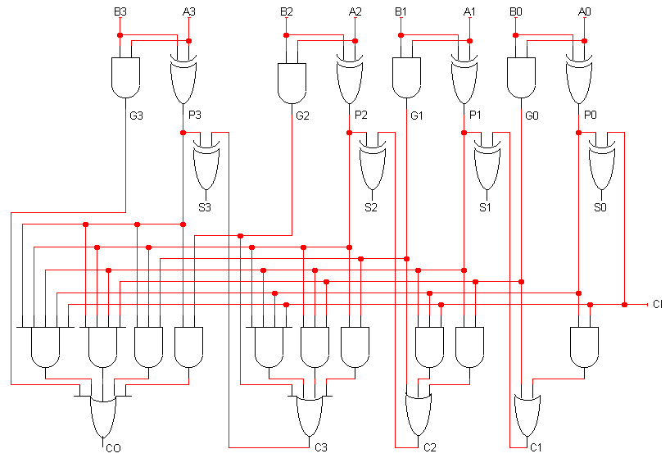
A 4-bit carry lookahead adder circuit
“carry-out”, not “c-zero”

Slide 17
Carry lookahead adders
This is called a carry lookahead adder.
By adding more hardware, we reduced the number of levels in the circuit and speed things up.
We can “cascade” carry lookahead adders, just like ripple carry adders. (We’d have to do carry lookahead between the adders too.)

Slide 18
Cascading Carry Lookahead Adders
A8-11 B8-11
A4-7 B4-7
A0-3 B0-3
S11
S10
S9
S8
S7
S6
S5
S4
S3
S2
S1
S0
Third Carry-out has a delay of 2 gates, but S9 has a delay of 3 gates_x0016__x0003__x0016__x0003__x0016_
First Carry-out has a delay of 3 gates_x0003__x0016_
Second Carry-out has a delay of 2 gates_x0003__x0016__x0003__x0016__x0003__x0016_
A 4-bit carry lookahed adder has a delay of 4 gates
A 12-bit carry lookahead adder has a delay of 3 + 2 + 3 = 8 gates
A 16-bit carry lookahead adder has a delay of 3 + 2 + 2 + 3 = 10 gates

Slide 19
Carry lookahead adders
How much faster is a carry lookahead adder?
  For a 4-bit adder: There are 4 gates in the longest path of a carry lookahead adder versus 9 gates for a ripple carry adder.
  For a 16-bit adder: There are 10 gates in the longest path of a carry lookahead adder versus 33 for a ripple carry adder.
  Newer CPUs these days use 64-bit adders!
The delay of a carry lookahead adder grows logarithmically with the size of the adder, while a ripple carry adder’s delay grows linearly.
The thing to remember about this is the trade-off between complexity and performance. Ripple carry adders are simpler, but slower. Carry lookahead adders are faster but more complex.

Slide 20
Addition summary
We can use circuits call full-adders to add three bits together to produce a two-bit output. The two outputs are called the sum (which is part of the answer) and the carry (which is just the same as the carry from the addition you learned to do by hand back in third grade.)
We can string several full adders together to get adders that work for numbers with more than one bit. By connecting the carry-out of one adder to the carry-in of the next, we get a ripple carry adder.
We can get fancy by using two-level circuitry to compute the carry-in for each adder. This is called carry lookahead. Carry lookahead adders can be much faster than ripple carry adders.

Slide 21
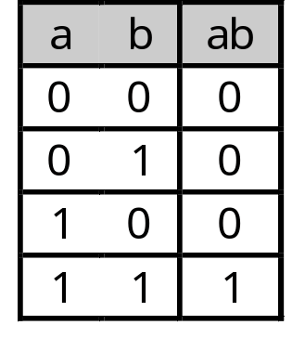
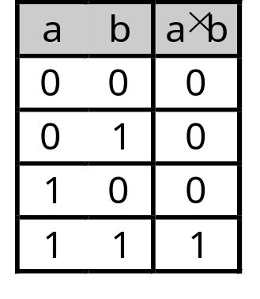
Multiplication
Multiplication can’t be that hard!
  It’s just repeated addition.
  If we have adders, we can do multiplication also.
Remember that the AND operation is equivalent to multiplication on two bits:

Slide 22
Binary multiplication example
Since we always multiply by either 0 or 1, the partial products are always either 0000 or the multiplicand (1101 in this example).
There are four partial products which are added to form the result.
  We can add them in pairs, using three adders.
  Even though the product has up to 8 bits, we can use 4-bit adders if we move them leftwards, like the partial products themselves.
1 1 0 1 Multiplicand
x 0 1 1 0 Multiplier
0 0 0 0 Partial products
1 1 0 1
1 1 0 1
+ 0 0 0 0
1 0 0 1 1 1 0 Product

Slide 23
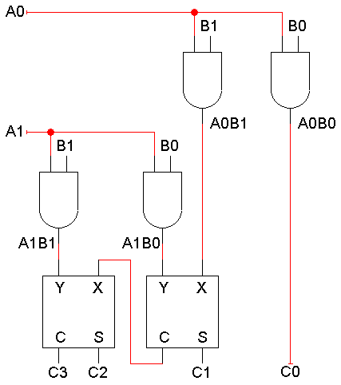
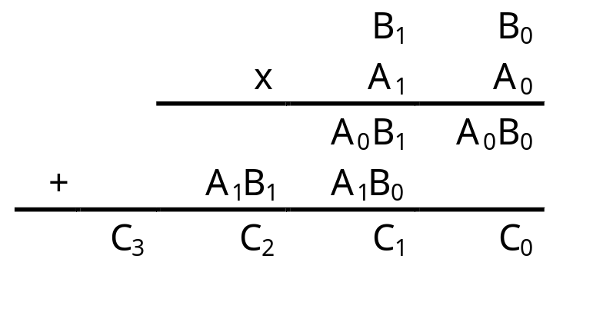
A 2x2 binary multiplier
The AND gates produce the partial products.
For a 2-bit by 2-bit multiplier, we can just use two half adders to sum the partial products. In general, though, we’ll need full adders.
Here C₃-C₀ are the product, not carries!

Slide 24
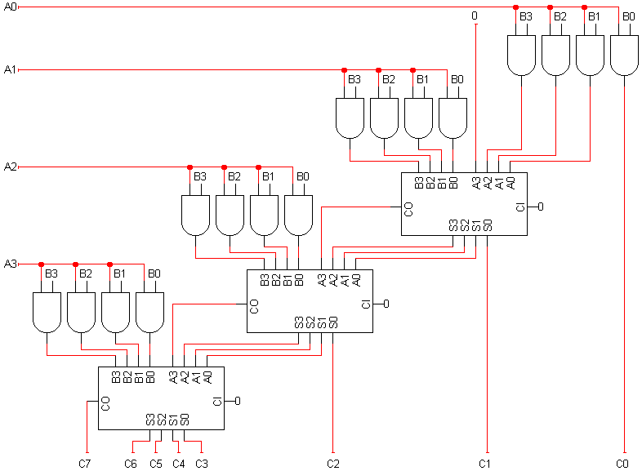
A 4x4 multiplier circuit

Slide 25
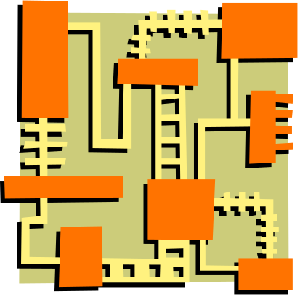
More on multipliers
Notice that this 4-bit multiplier produces an 8-bit result.
  We could just keep all 8 bits.
  Or, if we needed a 4-bit result, we could ignore C4-C7, and consider it an overflow condition if the result is longer than 4 bits.
Multipliers are very complex circuits.
  In general, when multiplying an m-bit number by an n-bit number:
    There are n partial products, one for each bit of the multiplier.
    This requires n-1 adders, each of which can add m bits (the size of the multiplicand).
  The circuit for 32-bit or 64-bit multiplication would be huge!

Slide 26
Multiplication: a special case
In decimal, an easy way to multiply by 10 is to shift all the digits to the left, and tack a 0 to the right end.
128 x 10 = 1280
We can do the same thing in binary. Shifting left is equivalent to multiplying by 2:
11 x 10 = 110 (in decimal, 3 x 2 = 6)
Shifting left twice is equivalent to multiplying by 4:
11 x 100 = 1100 (in decimal, 3 x 4 = 12)
As an aside, shifting to the right is equivalent to dividing by 2.
110 ÷ 10 = 11 (in decimal, 6 ÷ 2 = 3)

Slide 27
Addition and multiplication summary
Adder and multiplier circuits mimic human algorithms for addition and multiplication.
Adders and multipliers are built hierarchically.
  We start with half adders or full adders and work our way up.
  Building these functions from scratch with truth tables and K-maps would be pretty difficult.
The arithmetic circuits impose a limit on the number of bits that can be added. Exceeding this limit results in overflow.
There is a tradeoff between simple but slow circuits (ripple carry adders) and complex but fast circuits (carry lookahead adders).
Multiplication and division by powers of 2 can be handled with simple shifting.

